Slide 1
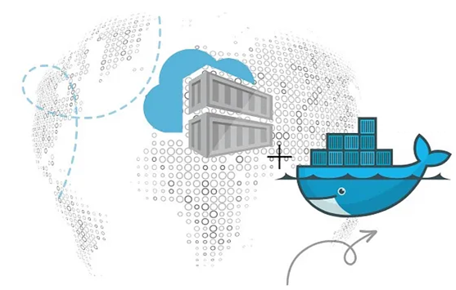

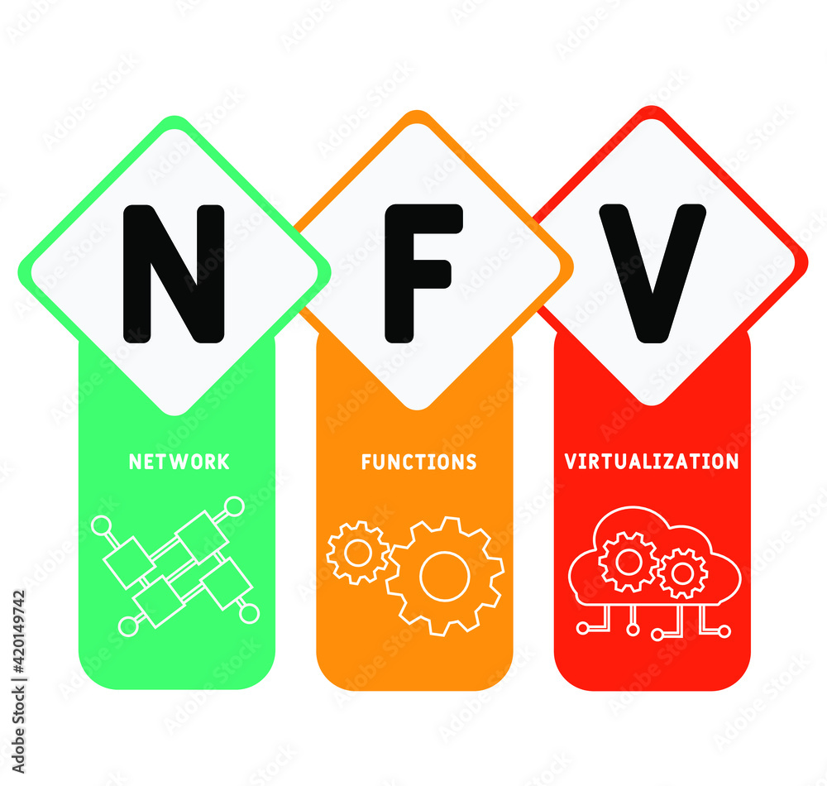
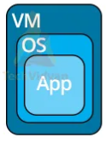
PDS
Computer Vision
Chapter 5_4-Q3:
MQTT-CoAP-AMQP-HTTP
https://github.com/siagianp
https://www.youtube.com/@AmelOline/videos
https://github.com/amelcharolinesgn2/IoT_simulator-mqtt-NodeRed
https://github.com/amelcharolinesgn2/Cloud-Infrastructures
https://github.com/amelcharolinesgn2/ClouD-Infrastructure-SISKA-2025
Notes:
Performance evaluation of CoAP and MQTT with security support for IoT environments
Author links open overlay panelVictor Seoane
https://www.sciencedirect.com/science/article/pii/S1389128621003364
https://www.mi.fu-berlin.de/inf/groups/ag-tech/teaching/2012-13_WS/L_19528_Embedded_Internet_and_the_Internet_of_Things/08.pdf
https://www.hivemq.com/blog/mqtt-vs-coap-for-iot/
https://thingsboard.io/docs/user-guide/integrations/coap/
Performance evaluation of CoAP and MQTT with security support for IoT environments
Author links open overlay panelVictor Seoane, Carlos Garcia-Rubio
https://www.sciencedirect.com/science/article/pii/S1389128621003364

Slide 2
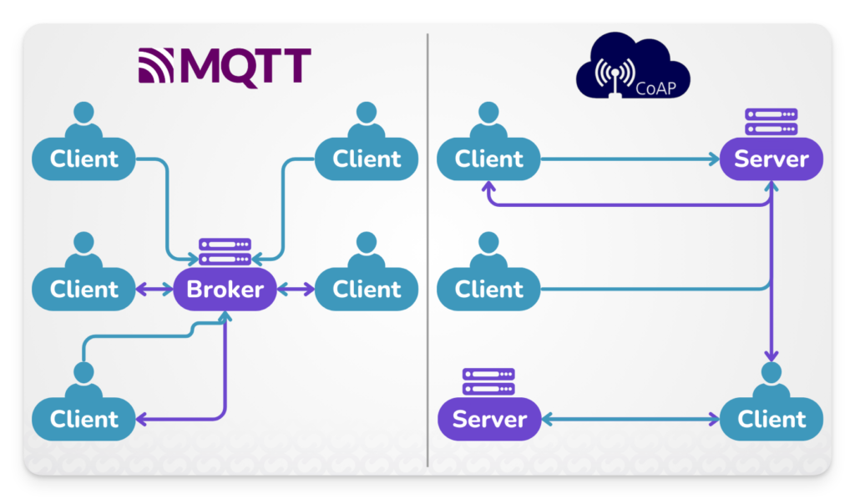
MQTT vs CoAP Comparison
Features | MQTT | CoAP
Base Protocol | TCP | UDP
Communication Model | Publish-Subscribe | Request-Response (RESTful)
Energy Consumption | Higher than CoAP | Lower than MQTT
Reliability | 3 QoS levels (Quality of Service) | Message confirmation (ACK)
Header Size | 2 bytes | 4 bytes
Security | TLS/SSL | DTLS or IPSec
Recommended Use Cases | Remote or unstable network connections | Low-power, low-latency environments
Factors to consider:
Network conditions: MQTT is better suited for unstable or high-latency networks due to its QoS guarantees. CoAP, on the other hand, excels in bandwidth-limited environments.
Device capabilities: If you are working with devices with limited memory and processing power, CoAP may be more efficient due to its lightweight design.
Reliability requirements: For critical applications requiring guaranteed message delivery, MQTT’s robust QoS options are an advantage.
Security: Both protocols offer security options, but their implementations vary. MQTT uses TLS/SSL, while CoAP employs DTLS or IPSec to secure transmissions.
Notes:
https://www.cloud.studio/coap-vs-mqtt/

Slide 3
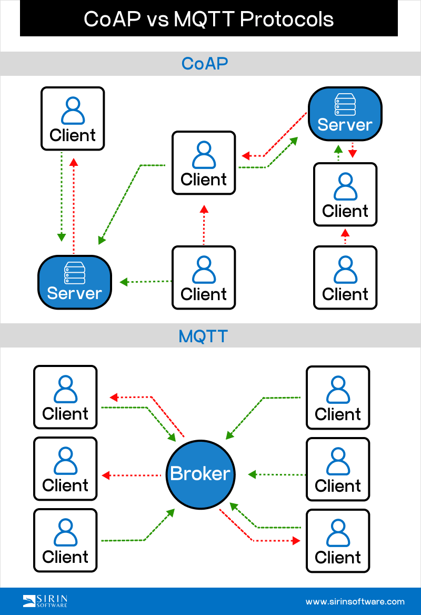
Exploring CoAP and MQTT protocols
CoAP vs MQTT protocols
Notes:
https://www.linkedin.com/posts/sirinsoftware_iot-coap-mqtt-activity-7222546493948268544-oakG

Slide 4
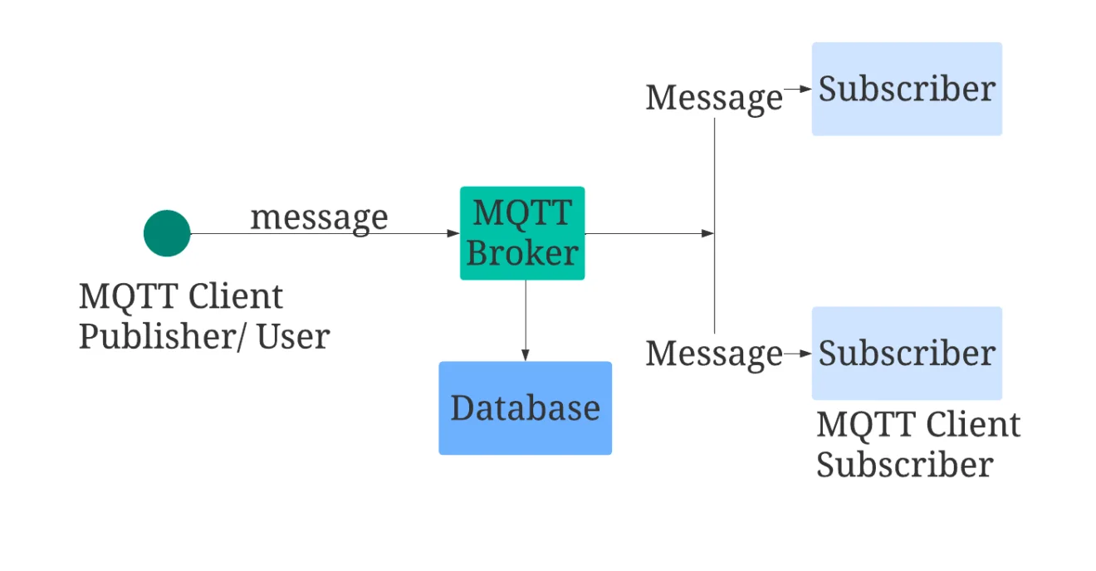
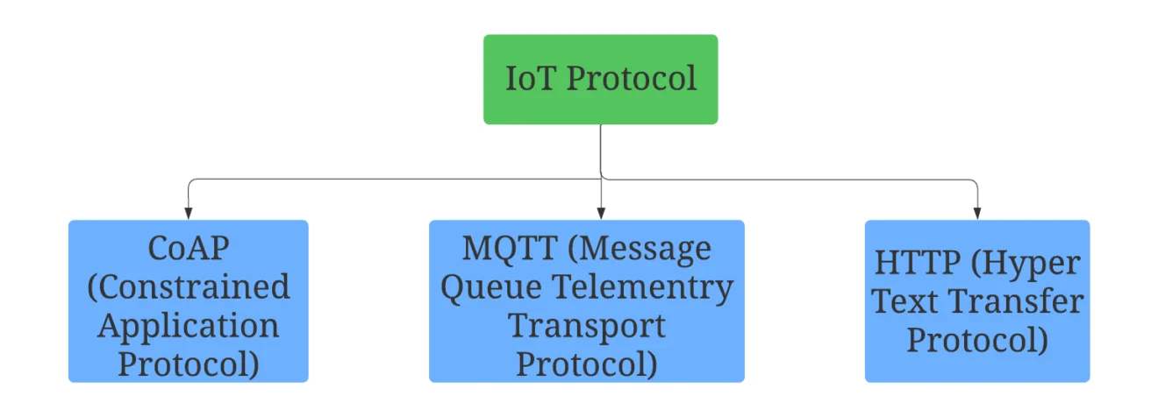

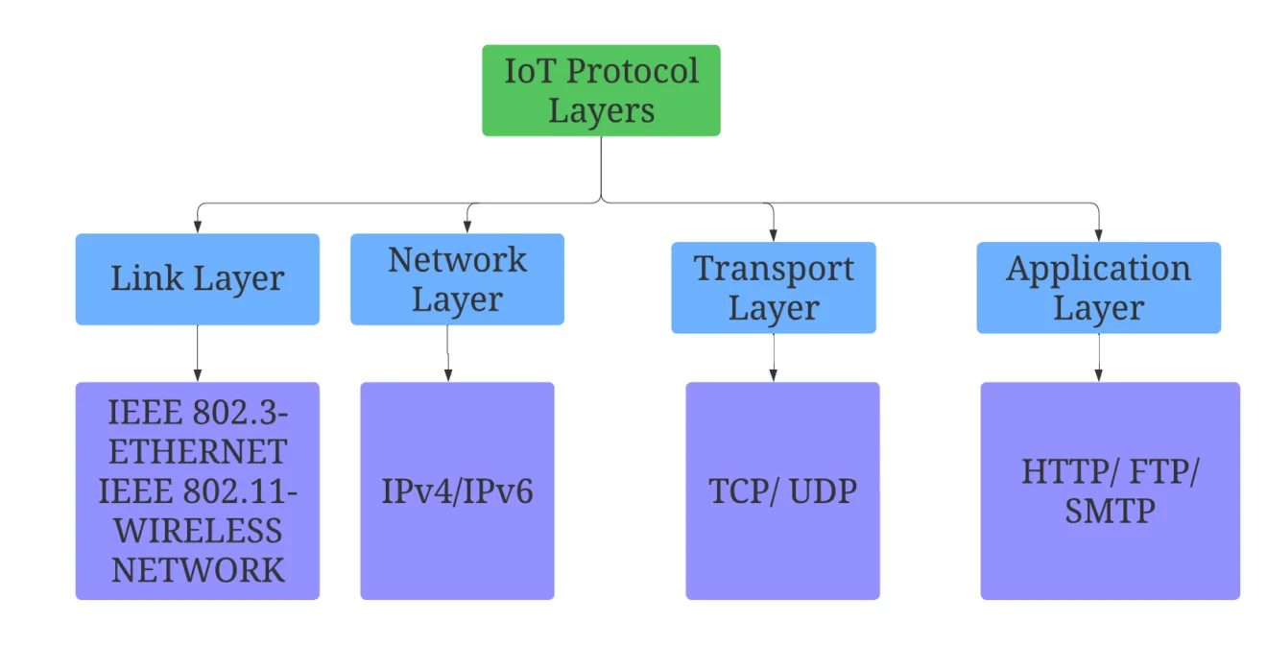
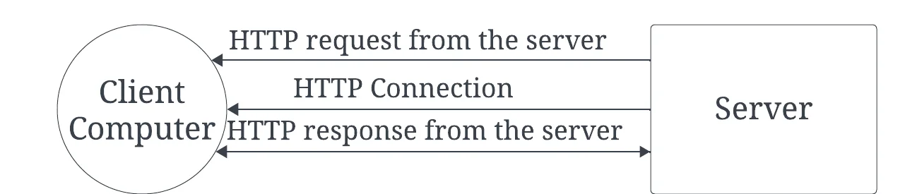
IoT Protocols: Comparing MQTT, CoAP, and HTTP for Efficient Device Communication
MQTT
CoAP
Types of IoT Protocols
HTTP
IoT Protocol Layers
Notes:
https://insights2techinfo.com/iot-protocols-comparing-mqtt-coap-and-http-for-efficient-device-communication/
https://bisaioti.com/mqtt-vs-http-vs-coap/

Slide 5
IoT Protocols: Comparing MQTT, CoAP, and HTTP for Efficient Device Communication
Comparison of MQTT, CoAP, HTTP
Protocol | Message Frequency | Message Size | Bits per Second | Effective Device Communication
MQTT | Variable, Low | Small | Moderate to High | Efficient, Low Overhead
CoAP | Variable, Moderate | Small to Medium | Moderate to High | Efficient, Designed for IoT
HTTP | Variable, High | Medium to Large | High | Common, Higher Overhead
Notes:
https://insights2techinfo.com/iot-protocols-comparing-mqtt-coap-and-http-for-efficient-device-communication/
https://bisaioti.com/mqtt-vs-http-vs-coap/

Slide 6
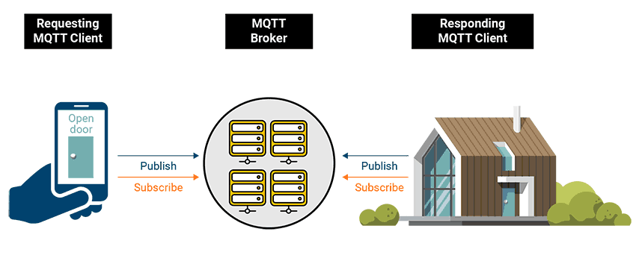
MQTT and CoAP
Notes:
https://www.hivemq.com/blog/mqtt-essentials-part-1-introducing-mqtt/
https://www.hivemq.com/blog/mqtt-essentials-part-1-introducing-mqtt/

Slide 7
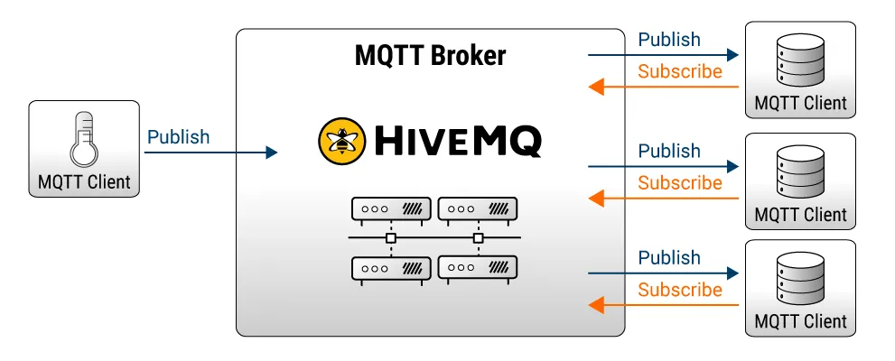
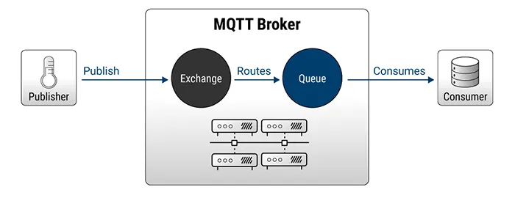
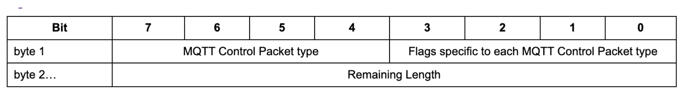
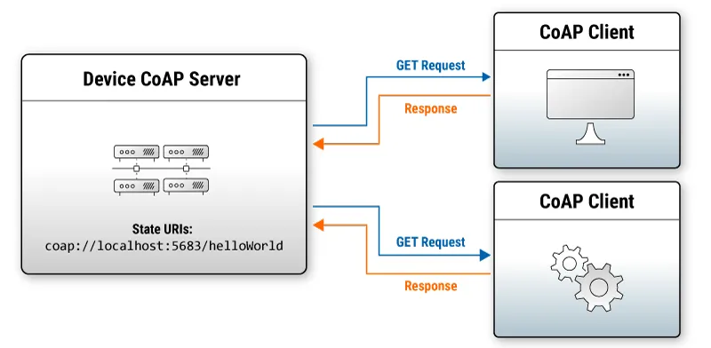
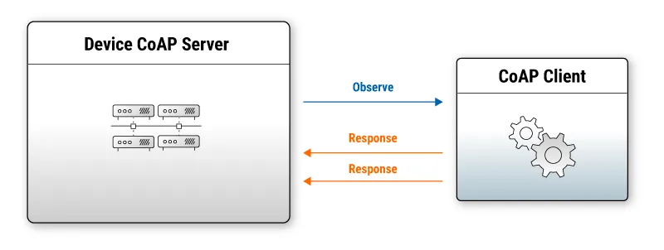
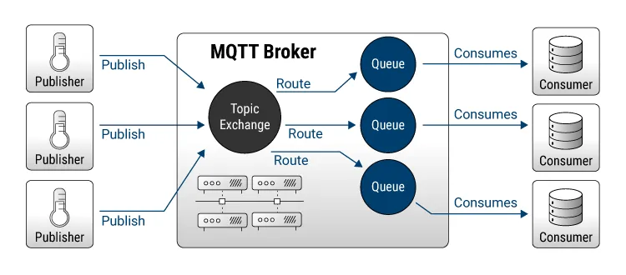
MQTT vs AMQP for IoT
MQTT
AMQP
MQTT is a communication protocol with features specifically targeted at IoT solutions:
Uses TCP connections, for reliability (assured delivery and packet error checking), fragmentation and ordering.
Aims to minimize data overhead of each MQTT packet.
The last known good data value for a device can be stored (retained messages).
Notifications when client unexpectedly disconnects (will message) to allow client state to be monitored.
Bi-directional message flow - data from and commands to devices can use the same TCP connection.
Publish subscribe routing, which allows the easy addition of more consumers and producers of data.
There are four predefined exchange types:
Direct - routing key matches queue name
Fanout - every queue bound to it receives every message
Topic - messages are routed to queues based on the pattern used when binding the queue to the exchange
Headers - similar to the topic exchange but uses message headers in the matching algorithm
CoAP
AMQP topology which could approximate an MQTT broker configuration:
AMQP has features which do not exist in MQTT or only in MQTT 5.0 such as:
Message headers (in MQTT 5.0)
Multiple lightweight connections over one TCP connection (channels)
Virtual hosts (isolated server environments)
Notes:
Comparing MQTT and AMQP https://www.hivemq.com/blog/mqtt-vs-amqp-for-iot/
https://www.hivemq.com/blog/mqtt-essentials-part-1-introducing-mqtt/

Slide 8
MQTT vs AMQP for IoT Comparison
 | MQTT | AMQP
Full name | MQTT (the OASIS standardization group decided it would not stand for anything) | Advanced Message Queuing Protocol
Architecture | Publish subscribe (MQTT does have a request/reply mode as well) | Queues, multicast (fanout), publish subscribe, request reply
Command targets | Topics | Exchanges, Queues
Underlying Protocol | TCP/IP | TCP/IP
Secure connections | TLS + username/password (SASL support possible) | TLS + username/password (SASL support possible)
Client observability | Known connection status (will messages) | Unknown connection status
Messaging Mode | Asynchronous, event-based | Synchronous and asynchronous
Message queuing | The broker can queue messages for disconnected subscribers | Core capability, flexible configuration
Message overhead | 2 bytes minimum | 8 bytes (general frame format)
Message Size | 256MB maximum | 2GB theoretical, 128MB max recommended
Content type | Any (binary) | Any (binary)
Topic matching | Level separator: / Wildcards: + # | Level separator: / Wildcards: + #
Reliability | Three qualities of service: 0 - fire and forget 1 - at least once 2 - once and only once | Two qualities of service: -without acks (=0) - with acks (=1)
Connection “multiplexing” | No | Yes - channels
Message attributes | MQTT 5.0 only | Yes
Object persistence | Yes | Yes
Notes:
Comparing MQTT and AMQP https://www.hivemq.com/blog/mqtt-vs-amqp-for-iot/
https://ijcsmc.com/docs/papers/September2020/V9I9202019.pdf

Slide 9
MQTT vs CoAP for IoT Comparison
 | MQTT | CoAP
Full name | MQTT (the OASIS standardization group decided it would not stand for anything) | The Constrained Application Protocol
Architecture | Client/Server | Client/Server
Command targets | Topics | URIs
Underlying transport | TCP | UDP
Default insecure TCP port | 1883 | 5684
Default secure UDP port | 8883 | 5684
Secure connections | TLS + username/password (SASL support possible) | DTLS (TLS for UDP)
Client observability | Known connection status (will messages) | None
Retained messages | Yes | No
Messaging Mode | Asynchronous, event-based | Synchronous (or asynchronous with observe extension)
Message queuing | The broker can queue messages for disconnected subscribers | None
Message overhead | 2 bytes minimum | 4 bytes minimum
Message Size | 256MB maximum | Limit of underlying transport - RFC 7252 suggests 1152 bytes for UDP if nothing is known about the target.
Message fragmentation | Reliant on TCP | No (RFC 7959 proposes an extension for this)
Content type | Any (binary) | Any
Pub/sub topic matching | Level separator: /Wildcards: + # | No pub/sub (but extensions have been proposed)
Message distribution | One to many, one to one | One to many, one to one
Reliability | Three qualities of service: 0 - fire and forget 1 - at least once 2 - once and only once | Confirmable or not (roughly equivalent to QoS 1 and 0)
Notes:
Comparing MQTT and AMQP https://www.hivemq.com/blog/mqtt-vs-amqp-for-iot/
https://ijcsmc.com/docs/papers/September2020/V9I9202019.pdf

Slide 10
MQTT Performance Vs. CoAP Performance
 | MQTT (TCP) Bytes | CoAP (UDP) Bytes
Establish connection | 166 | None
Subscribe | 159 | None
For each message published | 388 | 312+75 (request + response)
Sum for 1 message | 1101 | 387
Sum for 10 messages | 8085 | 3870
Sum for 100 messages | 77925 | 38700
GET to receive the data from the server before the subsequent GET. In each case, the messages are 256 bytes.
No. messages | Protocol | Msgs per second | Avg round trip time (ms)
10000 | MQTT - QoS 1 | 1,234 | 0.81
10000 | MQTT - QoS 0 | 18,416 | 0.054
10000 | CoAP | 8,729 | 0.1145
Notes:
https://www.hivemq.com/blog/mqtt-vs-coap-for-iot/

Slide 11
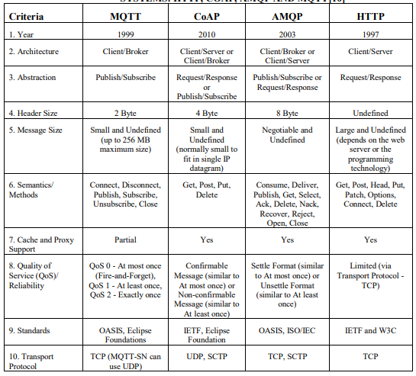
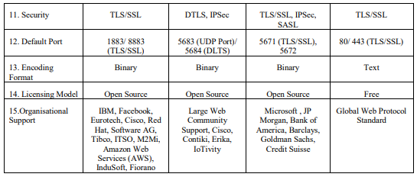
MQTT vs AMQP for IoT Comparison
COMPARATIVE ANALYSIS OF MESSAGING PROTOCOLS FOR IOT SYSTEMS: HTTP, COAP, AMQP AND MQTT[10]
Notes:
Comparing MQTT and AMQP https://www.hivemq.com/blog/mqtt-vs-amqp-for-iot/
A Brief Comparative Analysis on Application Layer Protocols of Internet of Things: MQTT, CoAP, AMQP and HTTP https://ijcsmc.com/docs/papers/September2020/V9I9202019.pdf

Slide 12
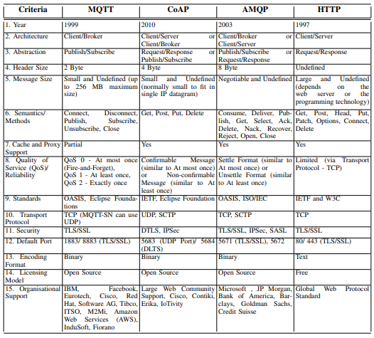
MQTT vs AMQP for IoT Comparison
Comparative Analysis of Messaging Protocols for IoT Systems: MQTT, CoAP, AMQP and HTTP
https://classes.engineering.wustl.edu/~jain/cse574-14/ftp/coap/
Notes:
Comparing MQTT and AMQP https://www.hivemq.com/blog/mqtt-vs-amqp-for-iot/
https://ijcsmc.com/docs/papers/September2020/V9I9202019.pdf
Constrained Application Protocol for Internet of Things
https://classes.engineering.wustl.edu/~jain/cse574-14/ftp/coap/
https://pure.port.ac.uk/ws/portalfiles/portal/12197128/IoT_Messaging_Protocols_Naik.pdf

Slide 13
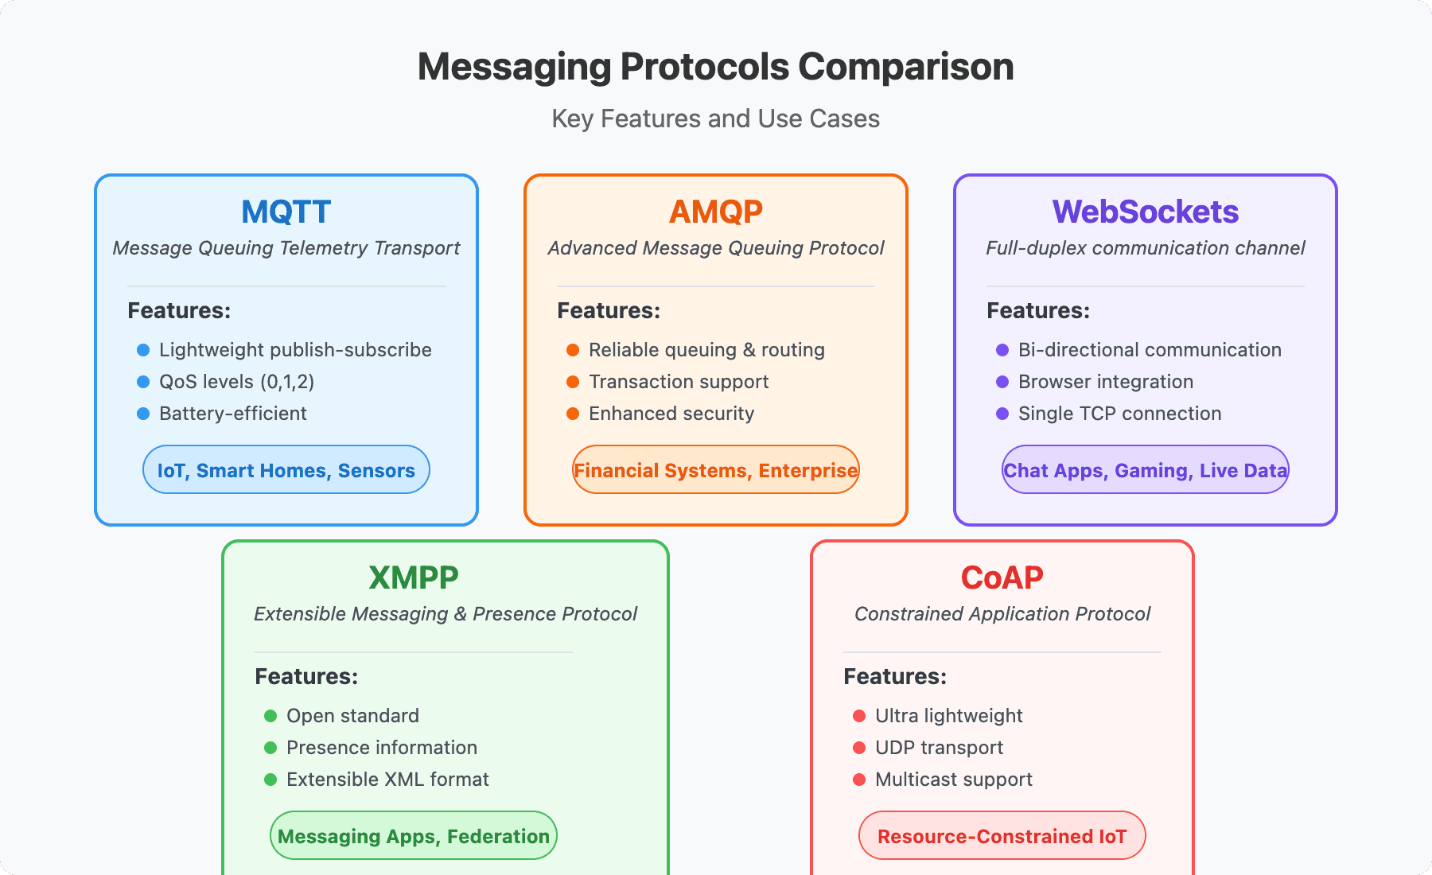
Messaging Protocols Explained: MQTT, AMQP, WebSockets, CoAP
MQTT, CoAP, AMQP and HTTP for IoT
Notes:
https://www.videosdk.live/developer-hub/websocket/messaging-protocols

Slide 14
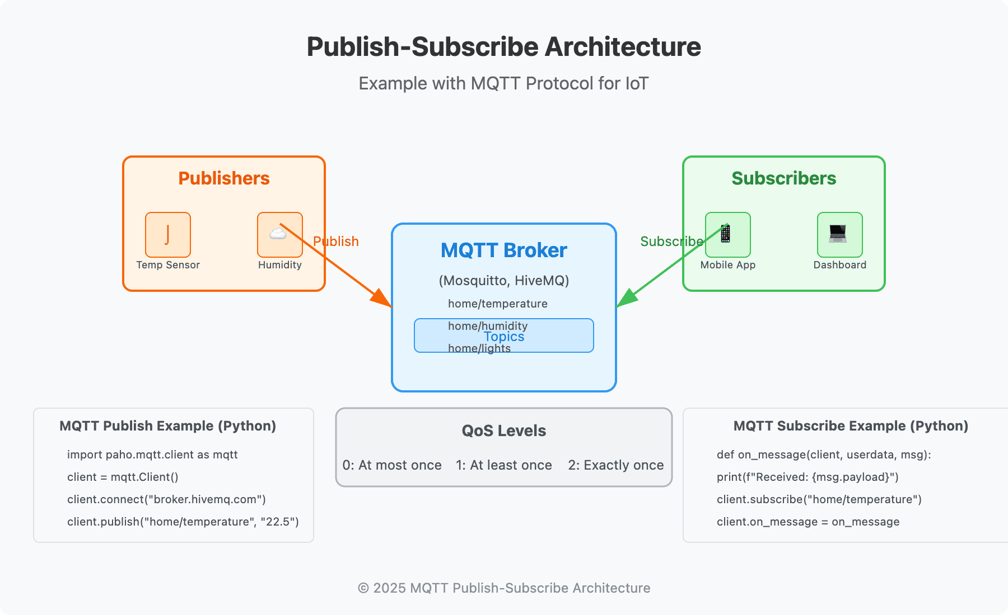

Slide 15
Constrained Application Protocol for Internet of Things
Notes:
https://classes.engineering.wustl.edu/~jain/cse574-14/ftp/coap/

Slide 16
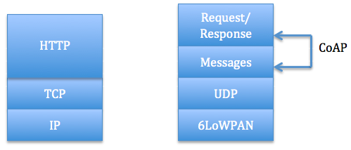
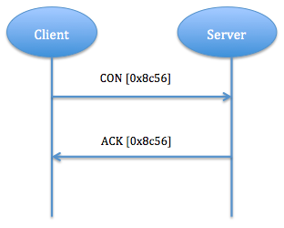
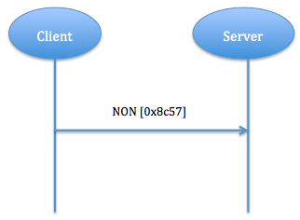
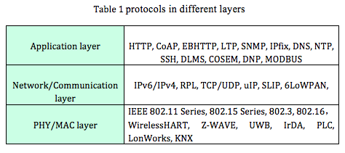
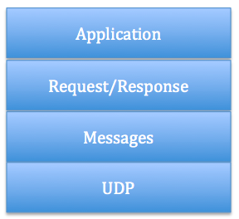
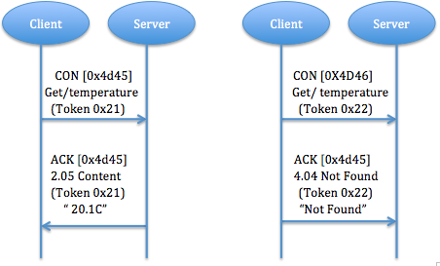
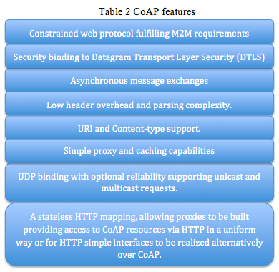
Constrained Application Protocol for Internet of Things
CoAP vs. HTTP
Message Layer model
Wireless Protocols for IoT
Protocols in Different Layers
Reliable message transport
Unreliable message transport
CoAP Structure Model
request/response Layer model
CoAP Features
Piggy-backed
Notes:
https://classes.engineering.wustl.edu/~jain/cse574-14/ftp/coap/
References
[Petersburg12] St. Petersburg, "Internet of Things, Smart Spaces, and Next Generation Networking," Russia, August 27-29, 2012 http://link.springer.com/book/10.1007%2F978-3-642-32686-8
[Z. Shelby13] Z. Shelby, Sensinode, K. Hartke, "Constrained Application Protocol (CoAP)," draft-ietf-core-coap-18. [2013-06--28] http://tools.ietf.org/html/draft-ietf-core-coap-18
[G.Tolle13] G.Tolle, Arch Rock Corporation. Embedded Binary HTTP (EBHTTP) draft-tolle-core-ebhttp-00.[2010-03-23] https://tools.ietf.org/html/draft-tolle-core-ebhttp-00
[Glombitza10] Glombitza, N.; Pfisterer, D.; Fischer, S., "LTP: An Efficient Web Service Transport Protocol for Resource Constrained Devices," Sensor Mesh and Ad Hoc Communications and Networks (SECON), 2010 7th Annual IEEE Communications Society Conference on , vol., no., pp.1,9, 21-25 June 2010 http://ieeexplore.ieee.org/document/5508255/
[S. Keoh13] S. Keoh, Philips Research, Z. Shelby,Sensinode. Profiling of DTLS for CoAP-based IoT Applications draft-keoh-dice-dtls-profile-iot-00 [2013-11-05] http://tools.ietf.org/html/draft-keoh-dice-dtls-profile-iot-00
[Koojana11] Koojana Kuladinithi, Olaf Bergmann, Thomas Potsch Markus Becker, Carmelita Gorg, "Implementation of CoAP and its Application in Transport Logistics," In Proceedings of the Workshop on Extending the Internet to Low power and Lossy Networks (April 2011) http://hinrg.cs.jhu.edu/joomla/images/stories/coap-ipsn.pdf
[Shelby11] Zach Shelby, "CoRE Link Format," draft-ietf-core-link- format-07 https://tools.ietf.org/html/draft-ietf-core-link-format-01
[Castellani12] Castellani, A.; Fossati, T.; Loreto, S., "HTTP-CoAP cross protocol proxy: an implementation viewpoint," Mobile Adhoc and Sensor Systems (MASS), 2012 IEEE 9th International Conference on , vol.Supplement, no., pp.1,6, 8-11 Oct. 2012 http://ieeexplore.ieee.org/document/6708523/
[Kothmayr12] A DTLS Based End-To-End Security Architecture for the Internet of Things with Two-way Authentication Thomas Kothmayr, Corinna Schimitt, Wen Hu, Michael Bruning. 2012 http://kothmayr.net/wp-content/papercite-data/pdf/kothmayr2012dtls.pdf
[Raza13] Raza, S.; Shafagh, H.; Hewage, K.; Hummen, R.; Voigt, T., "Lithe: Lightweight Secure CoAP for the Internet of Things," Sensors Journal, IEEE , vol.13, no.10, pp.3711,3720, Oct. 2013 http://ieeexplore.ieee.org/document/6576185/
[E. Rescorla12] E. Rescorlai, N. Modadugu, "Datagram Transport Layer Security Version 1.2," RFC Standard 6347, Jan. 2012. http://tools.ietf.org/html/rfc6347
[Hartke13] Klaus Hartke, Hannes Tschofenig, A DTLS Profile for the Internet of Things draft-hartke-dice-profile-00, [2013-11-04] http://tools.ietf.org/html/draft-hartke-dice-profile-00
[Bergmann12] Bergmann, O.; Hillmann, K.T.; Gerdes, S., "A CoAP-gateway for smart homes," Computing, Networking and Communications (ICNC), 2012 International Conference on, pp.446,450, Jan. 30 2012-Feb. 2 2012 http://ieeexplore.ieee.org/document/6167461/

Slide 17
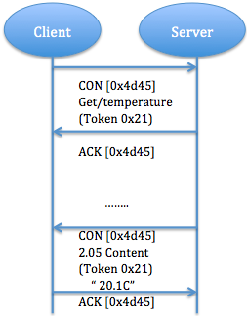
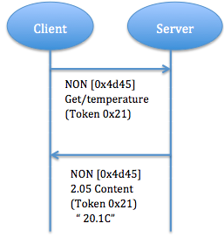
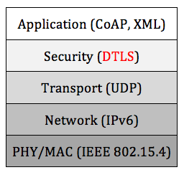
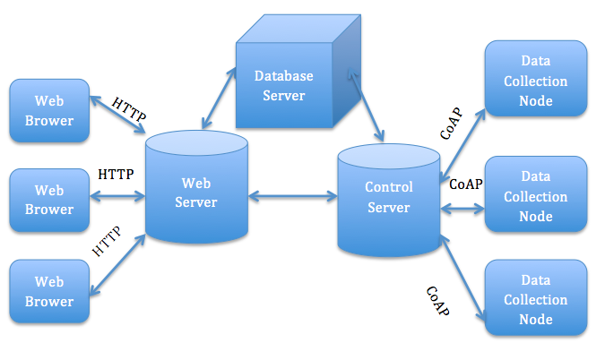
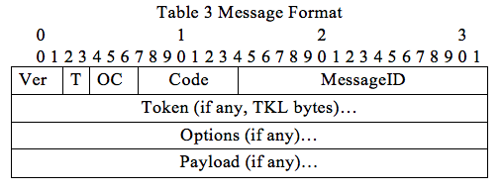
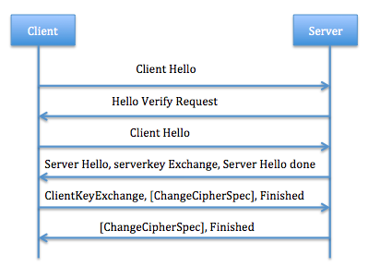
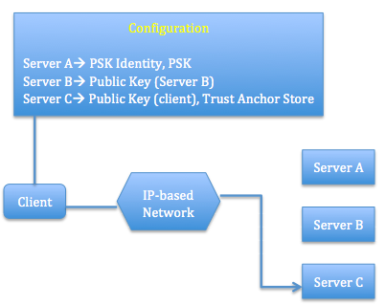
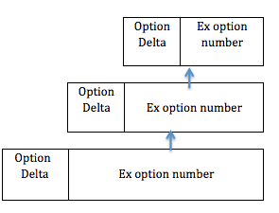
Constrained Application Protocol for Internet of Things
Security Protocol & Application for CoAP
Why use DTLS for CoAP Security
CoAP Application for Smart Homes
Separate response
Non confirmable request and response
Message Format
Structure of DTLS
Notes:
https://classes.engineering.wustl.edu/~jain/cse574-14/ftp/coap/
Acronyms
IoTInternet of ThingsIEFTInternet Engineering Task ForceCoAPConstrained Application ProtocolHTTPHypertext Transfer ProtocolHARTHighway Addressable Remote TransducerLR-WPANLow-Rate Wireless Personal Area NetworkEBHTTPEmbedded Binary HTTPLTPLean Transport ProtocolCoREConstrained RESTful EnvironmentsRESTRepresentation State TransferURIUniform Resource IdentifierP2PPoint to PointDTLSDatagram Transport Layer Security

Slide 18
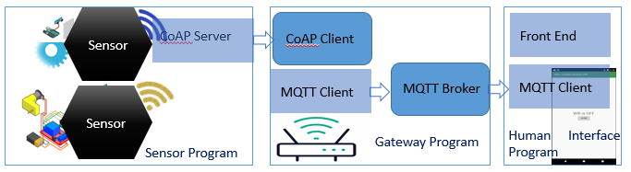
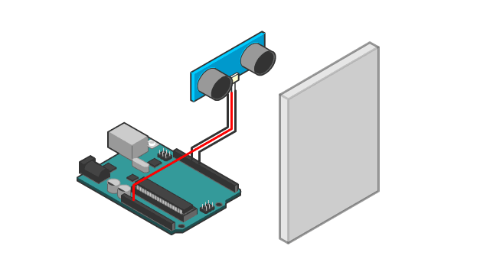
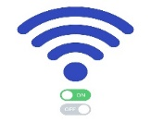

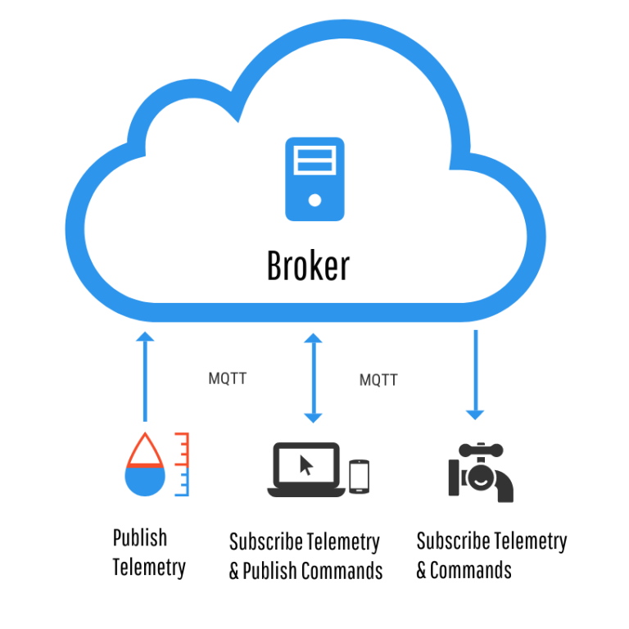
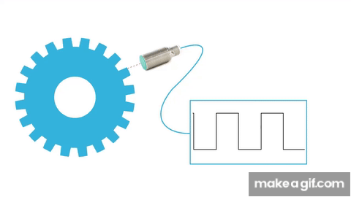
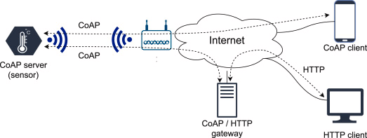
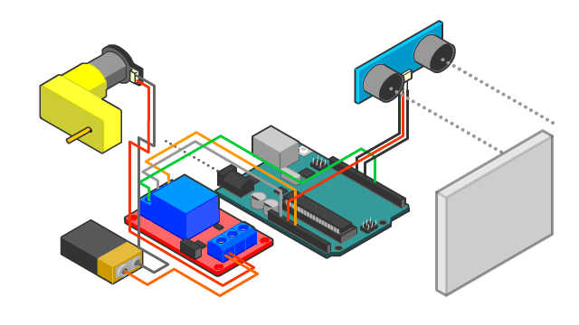

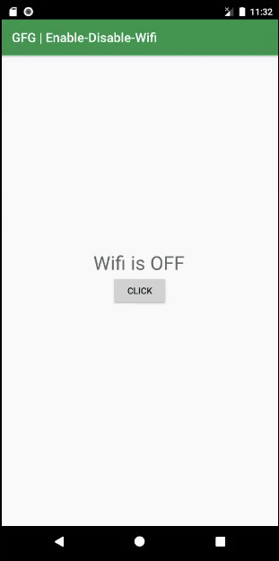



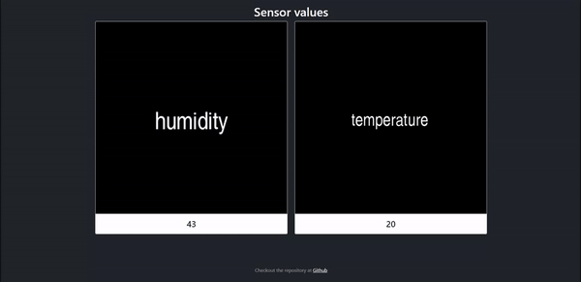
Lab-1
Implementation CoAP MQTT pipeline
Combined IoT system using both CoAP and MQTT protocol.
CoAP Server
CoAP Client
Front End
Sensors
MQTT Client
MQTT Broker
MQTT Client
Humadity, Temperature
Gateway Program
Human Interface Program
Sensor Program
Console output:
Real-time updated website:
Notes:
https://github.com/Adilius/CoAP-MQTT-pipeline-implementation
https://www.sciencedirect.com/science/article/pii/S1389128621003364
https://www.netburner.com/learn/vulnerable-designs-and-implementations-with-mqtt-and-coap-m2m-protocols/

Slide 19
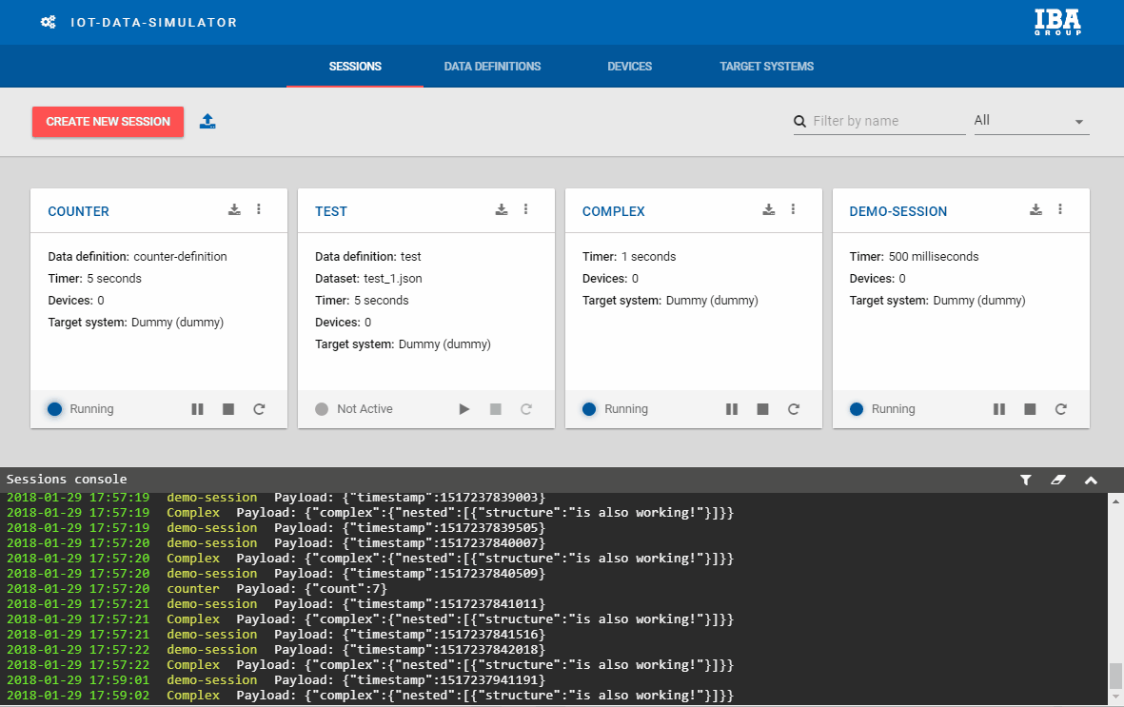
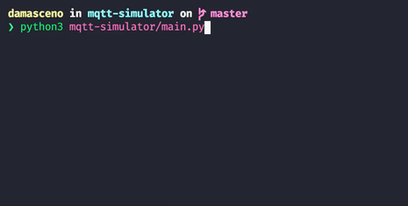
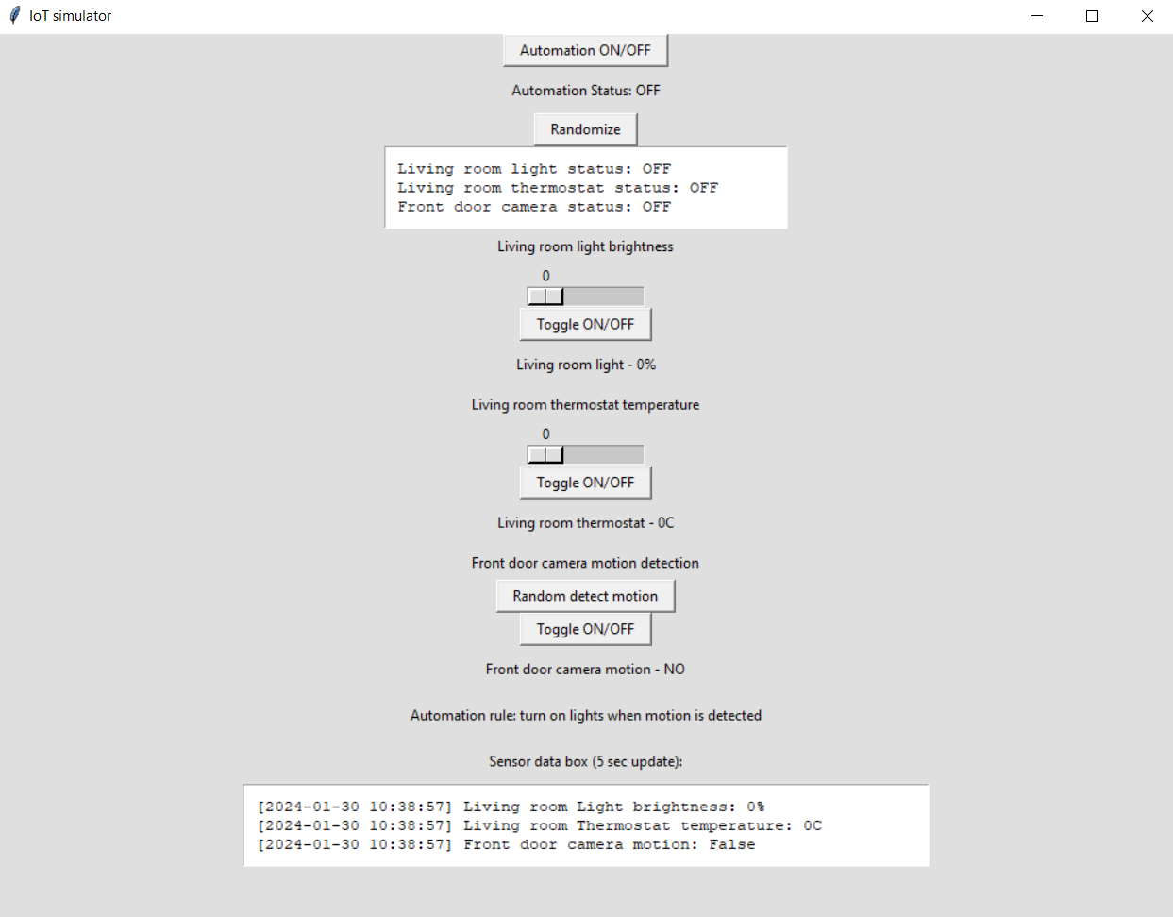
Lab2
MQTT Simulator
IoT-data-simulator
MQTT simulator written in Python 3 for publishing JSON objects to a broker, simulating sensors and devices.
DaemonGPU
IoT Simulator
Notes:
https://github.com/DamascenoRafael/mqtt-simulator
https://github.com/IBA-Group-IT/IoT-data-simulator
https://github.com/leedskiy/IoT-simulator
https://github.com/wenh77/Learning-IoT-CoAP

Slide 20
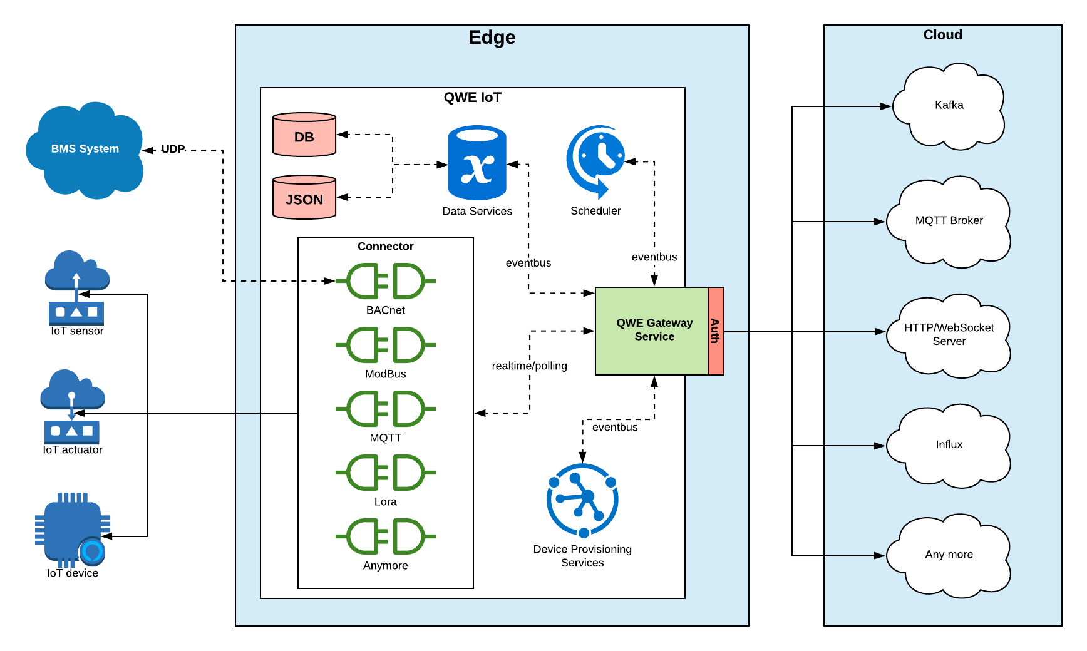
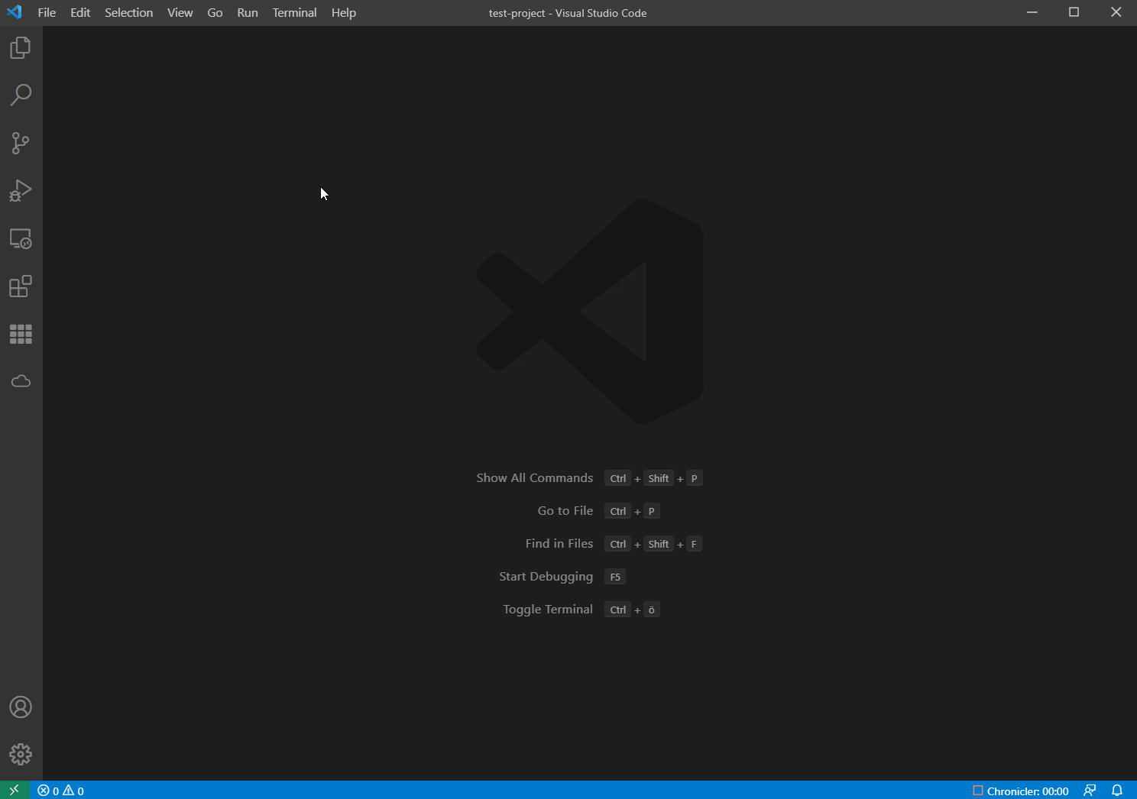


Lab-3
VSMQTT is a simple MQTT client integrated in vscode.
IoT Gateway
Smart-Roasting-Coffe-System
IoT Simulator
Notes:
https://github.com/rpdswtk/vsmqtt
https://github.com/play-iot/iot-gateway
https://github.com/martiFabia/Smart-Roasting-Coffe-System
https://github.com/mgiorgi13/Smart-Agricolture

Slide 21
HW
Kapan Sebaiknya Menggunakan Protokol MQTT, Coap, Http dalam Sistem IoT ?
Comparative Analysis of Power Consumption between MQTT and HTTP Protocols in an IoT Platform Designed and Implemented for Remote Real-Time Monitoring of Long-Term Cold Chain Transport Operations https://www.mdpi.com/1424-8220/23/10/4896
Notes:
https://bisaioti.com/mqtt-vs-http-vs-coap/
https://iotboys.com/what-is-coap-protocol-coap-vs-mqtt-comparison/

Slide 22
Thank you!
PDS
Computer Vision
Thank you For being a great class!
https://github.com/siagianp
https://www.youtube.com/@AmelOline/videos
https://github.com/amelcharolinesgn2/IoT_simulator-mqtt-NodeRed
https://github.com/amelcharolinesgn2/Cloud-Infrastructures
https://github.com/amelcharolinesgn2/ClouD-Infrastructure-SISKA-2025
Notes:
https://medium.com/buildpiper/simplifying-containerization-with-docker-run-command-2f74e114f42a
https://github.com/IBA-Group-IT/IoT-data-simulator
https://www.bevywise.com/blog/docker-mqtt-broker-easy-service-manageability/

